Slide 1
A Design Partnership For Socio-Environmental Science Investigations
¹Alec Bodzin, ²David Anastasio, ²Dork Sahagian, ³Kate Popejoy, ¹Tom Hammond, ⁴Breena Holland, and ⁵Scott Rutzmoser
¹Department of Education and Human Services, Lehigh University ²Earth and Environmental Sciences, Lehigh University ³Popejoy STEM, LLC
¹Department of Political Science, Lehigh University ⁵Library and Technology Services, Lehigh University
2018 American Geophysical Union Fall Meeting, Washington, DC December 10-14, 2018
DRL-1614216

Slide 2
Socio-Environmental Science Investigations (SESI)
Inquiry-based investigations
Map-based mobile data collection
Analysis with Web-based mapping software
Pedagogical frameworks of place-based education and socio-scientific investigations
Local issues
Field work in the local setting

Slide 3
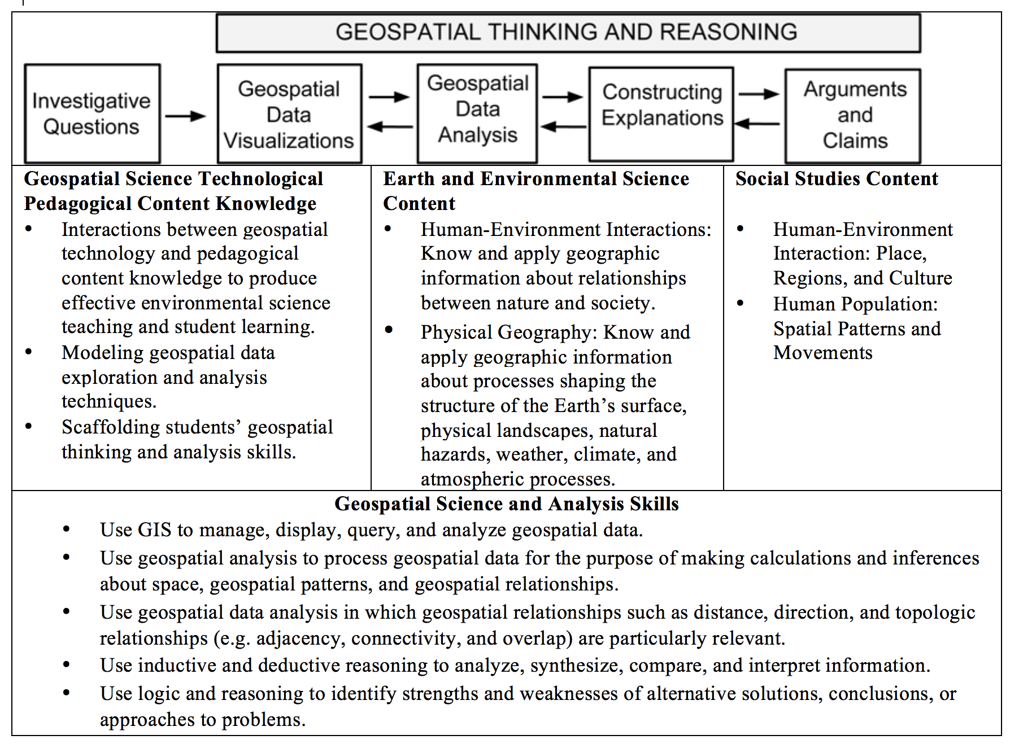

Slide 4
About Our School Partner
Urban public school
9th grade
All students economically disadvantaged
2/3 Hispanic or Latino
21% ELL, 19% IEPs
Many students are unengaged learners (but not all)
Unmotivated to learn
Do not complete tasks
Avoid challenging work

Slide 5
Design Partnership
Lehigh University natural science, social science, and education professors
School science and social studies teachers
Co-development of all curriculum materials – prototype, pilot-test, field-test
Hybrid Professional Development model - Active learning experiences - Collaboration - Reflect on teaching practices - Sufficient time to implement what has been learned
Notes:
A

Slide 6
Design Partnership – Leveraging Expertise
Rich discussions of content, STEM process skills, student engagement
Ensuring content is meaningful and relevant to students’ lives
Ensuring materials usable for diverse learners

Slide 7
SESI Investigations
Trees and Ecological Services Students identify trees and explore the environmental and societal benefits that trees provide in their city. They also investigate the relationship among trees and crime in their city.
Urban Heat Islands, Carbon Sequestration, Transportation Modes, Ecosystem Scavenger Hunt, Built Environment Scavenger Hunt, Zoning
Projects: Tree Planting, Built Environment, Culminating Project

Slide 8
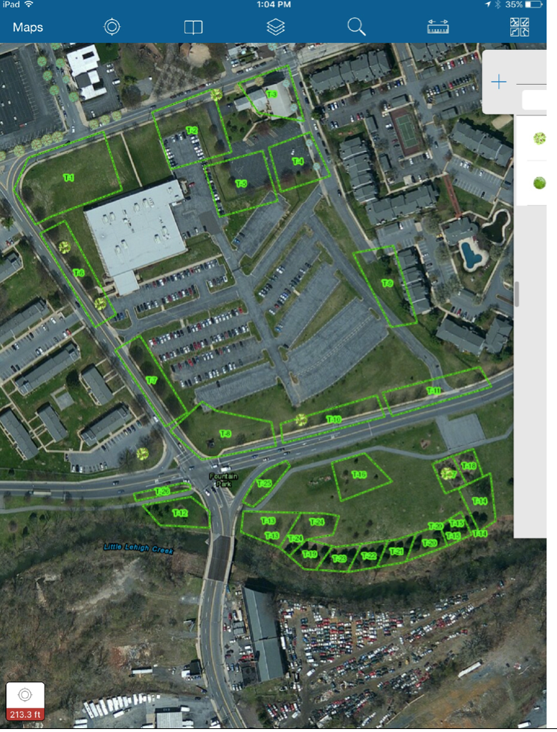
Data Gathering Areas
School

Slide 9
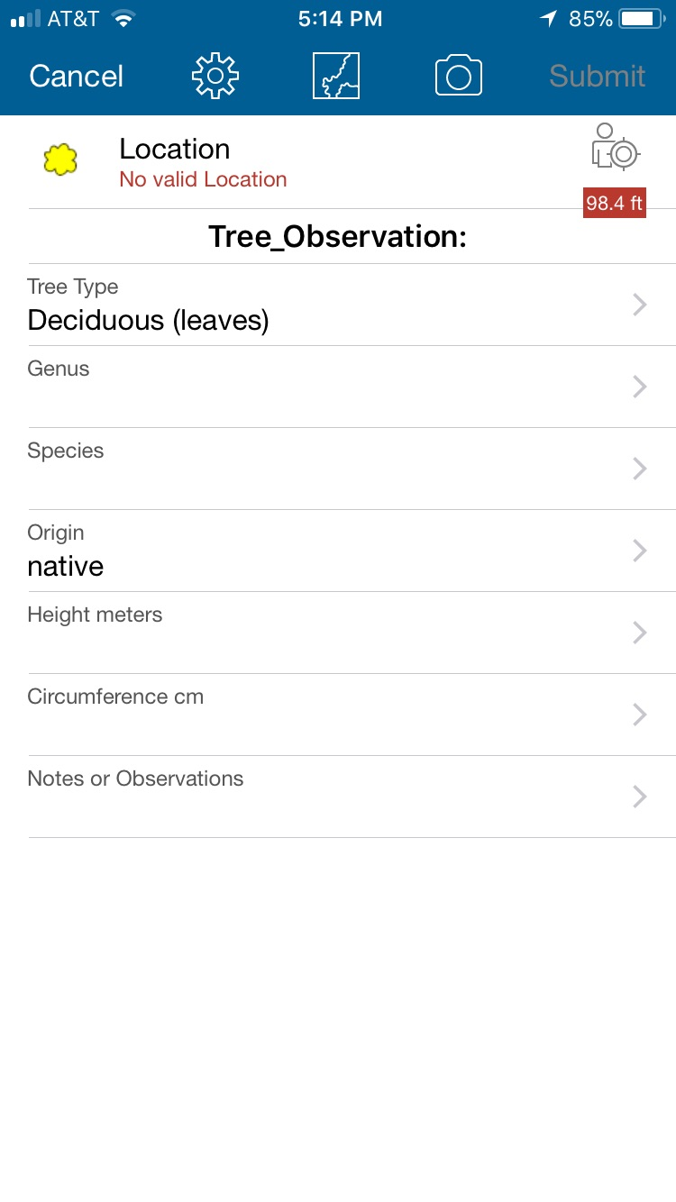
Data Gathering Interface

Slide 10
iBook pages

Slide 11
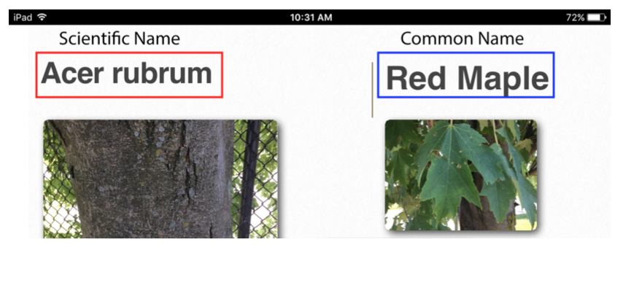

Slide 12
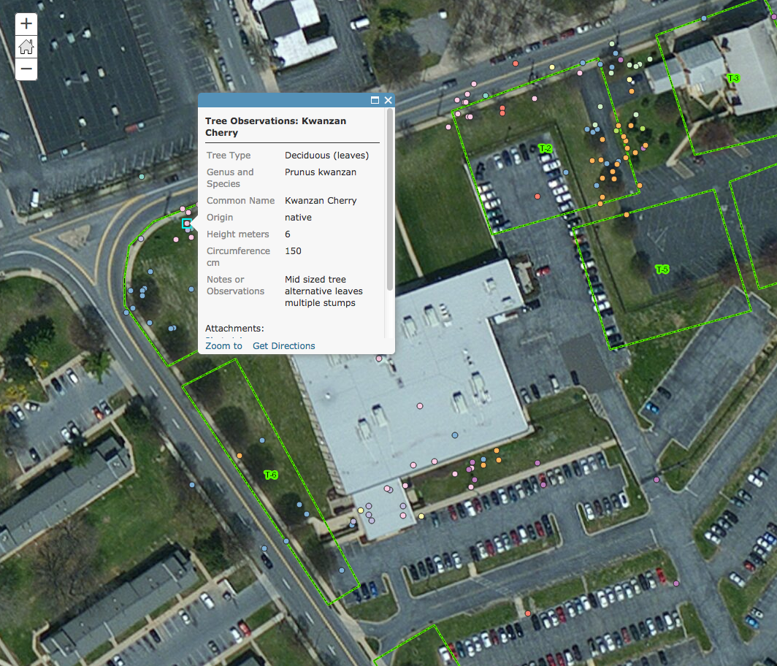
Student Data

Slide 13
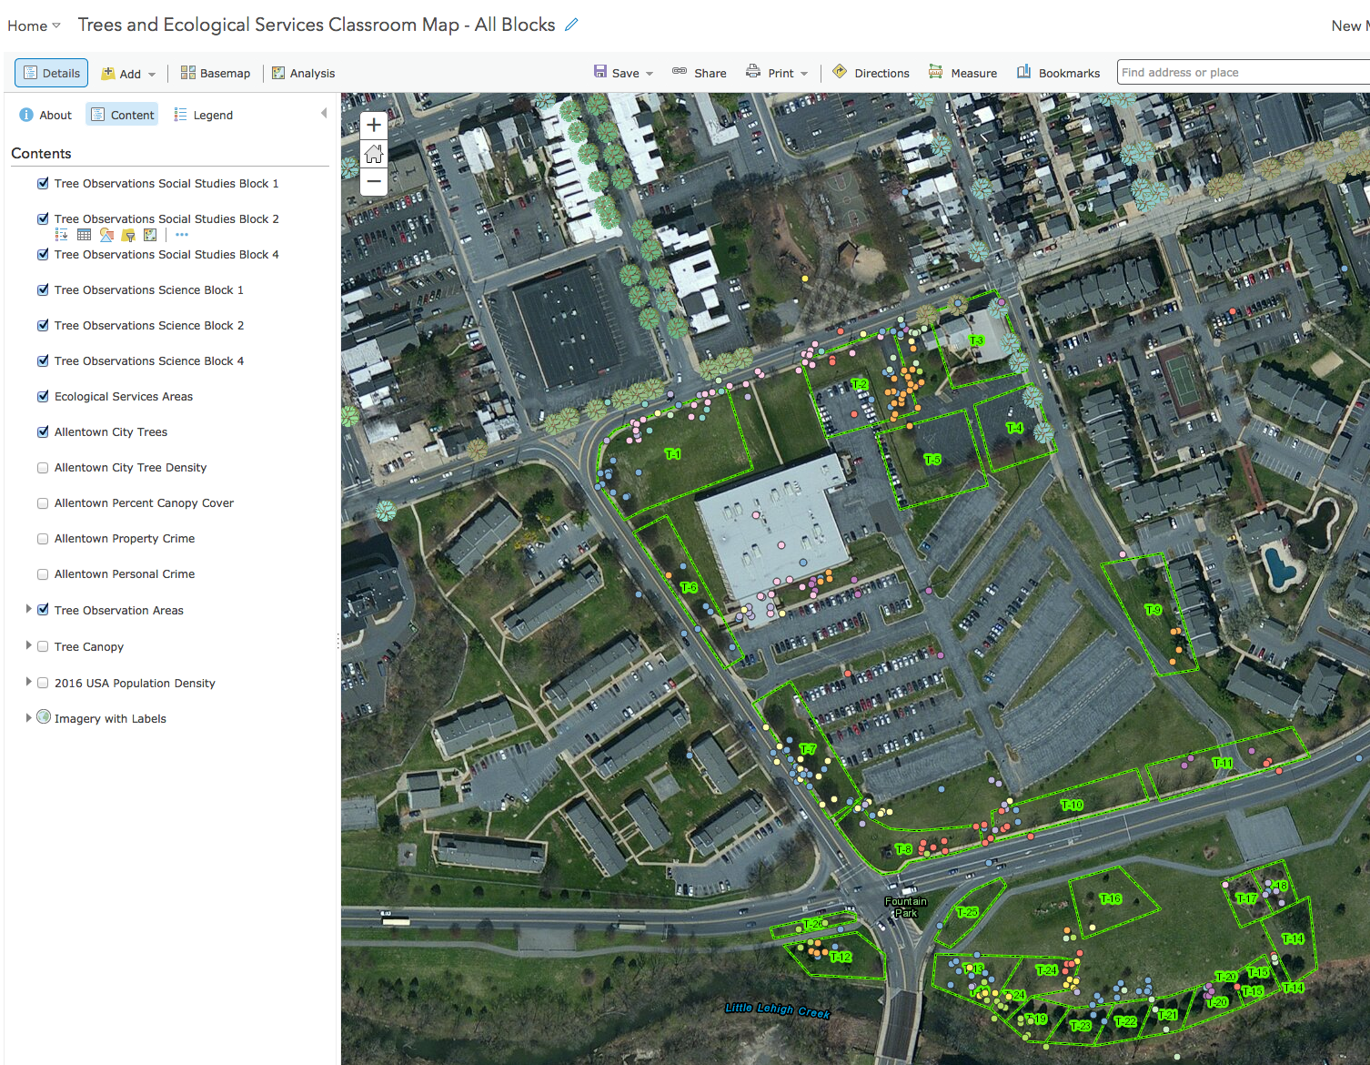
Using Filters for Data Analysis

Slide 14
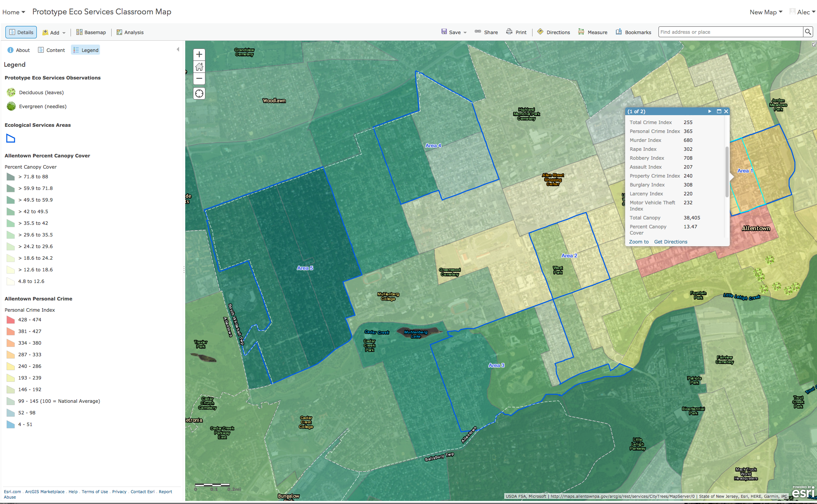
Personal and Property crime and % tree canopy

Slide 15
Factors that make design partnerships successful
Understand that teachers are very busy people
Regular meetings at the school
Hybrid PD – teachers’ schedules are more restrictive than academics
Relationship building is key
Develop trust
Share what you are learning
Listen carefully to the teachers

Slide 16
Benefits that scientists receive
Curriculum design and pedagogical models
Understanding learner characteristics
Interdisciplinary and multidisciplinary approaches to teaching and learning
Teaching and learning with GIS / new databases and software
Understanding visualizations as a pedagogical tool
Communication opportunities to present scientific concepts to be understood by non-specialists
Notes:
multi disciplinary because it combines social studies and science subjects, this is different than interdisciplinary e.g. neighborhood improvement, zoning using data, exemplified by culminating projects

Slide 17
Questions and Comments
SESI materials are available at: https://eli.lehigh.edu/sesi/
To access assessment materials: Login: eliteacher Password: 87dja92

