Slide 1
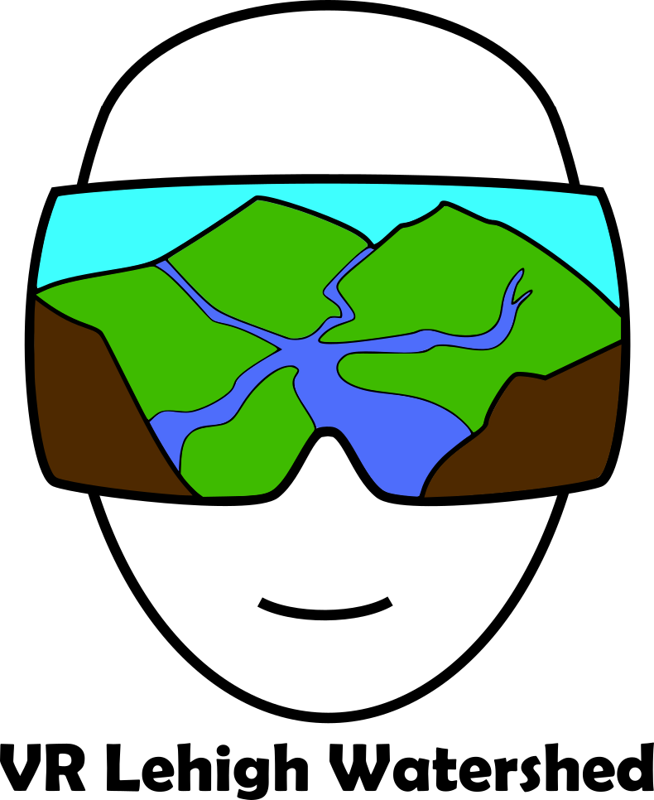
Developing An Immersive Virtual Reality Environment To Explore The Lehigh Gap
¹Alec Bodzin, ²David Anastasio, ¹Farah Vallera, ¹Tom Hammond, ²Scott Rutzmoser, and ¹Robson Martins De Araujo Junior
¹Department of Education and Human Services ²Earth and Environmental Sciences ³Library and Technology Services Lehigh University
2018 American Geophysical Union Fall Meeting, Washington, DC December 10-14, 2018

Slide 2
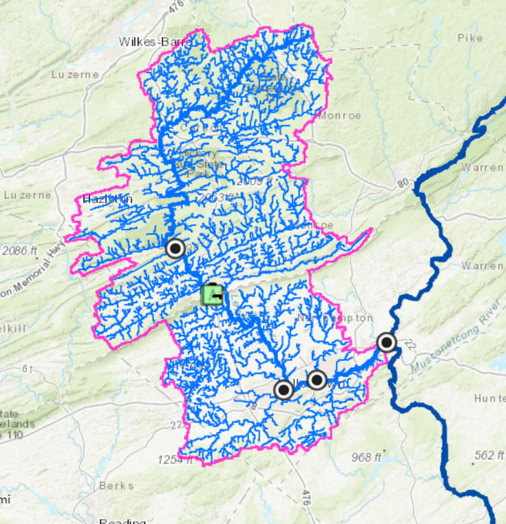
What? A virtual reality version of…
Prototype Version Goals
Authenticity
Realism
Engagement
Why? Research on…
Pedagogical benefits Immersion → engagement, motivation, content learning
Designing for VR learning
Language learners
Students with disabilities
Lehigh
Gap
Bethlehem

Slide 3
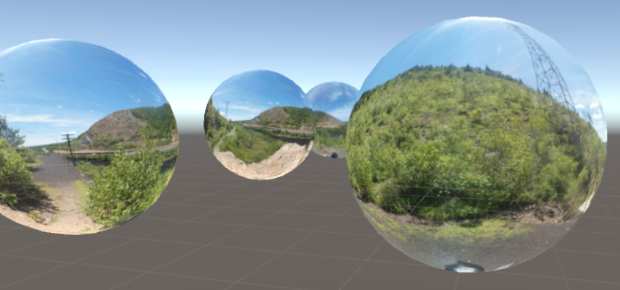
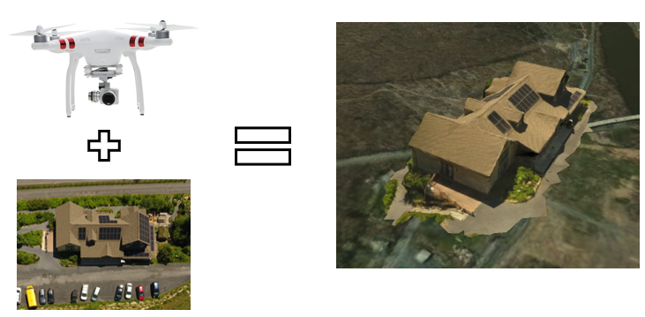
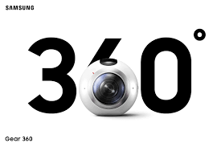
A realistic model of the Lehigh River Watershed
The Story: • Geography of the Lehigh Gap
• Historical Transportation Hub
• Zinc Smelting -> Moonscape -> Revegetation

Slide 4
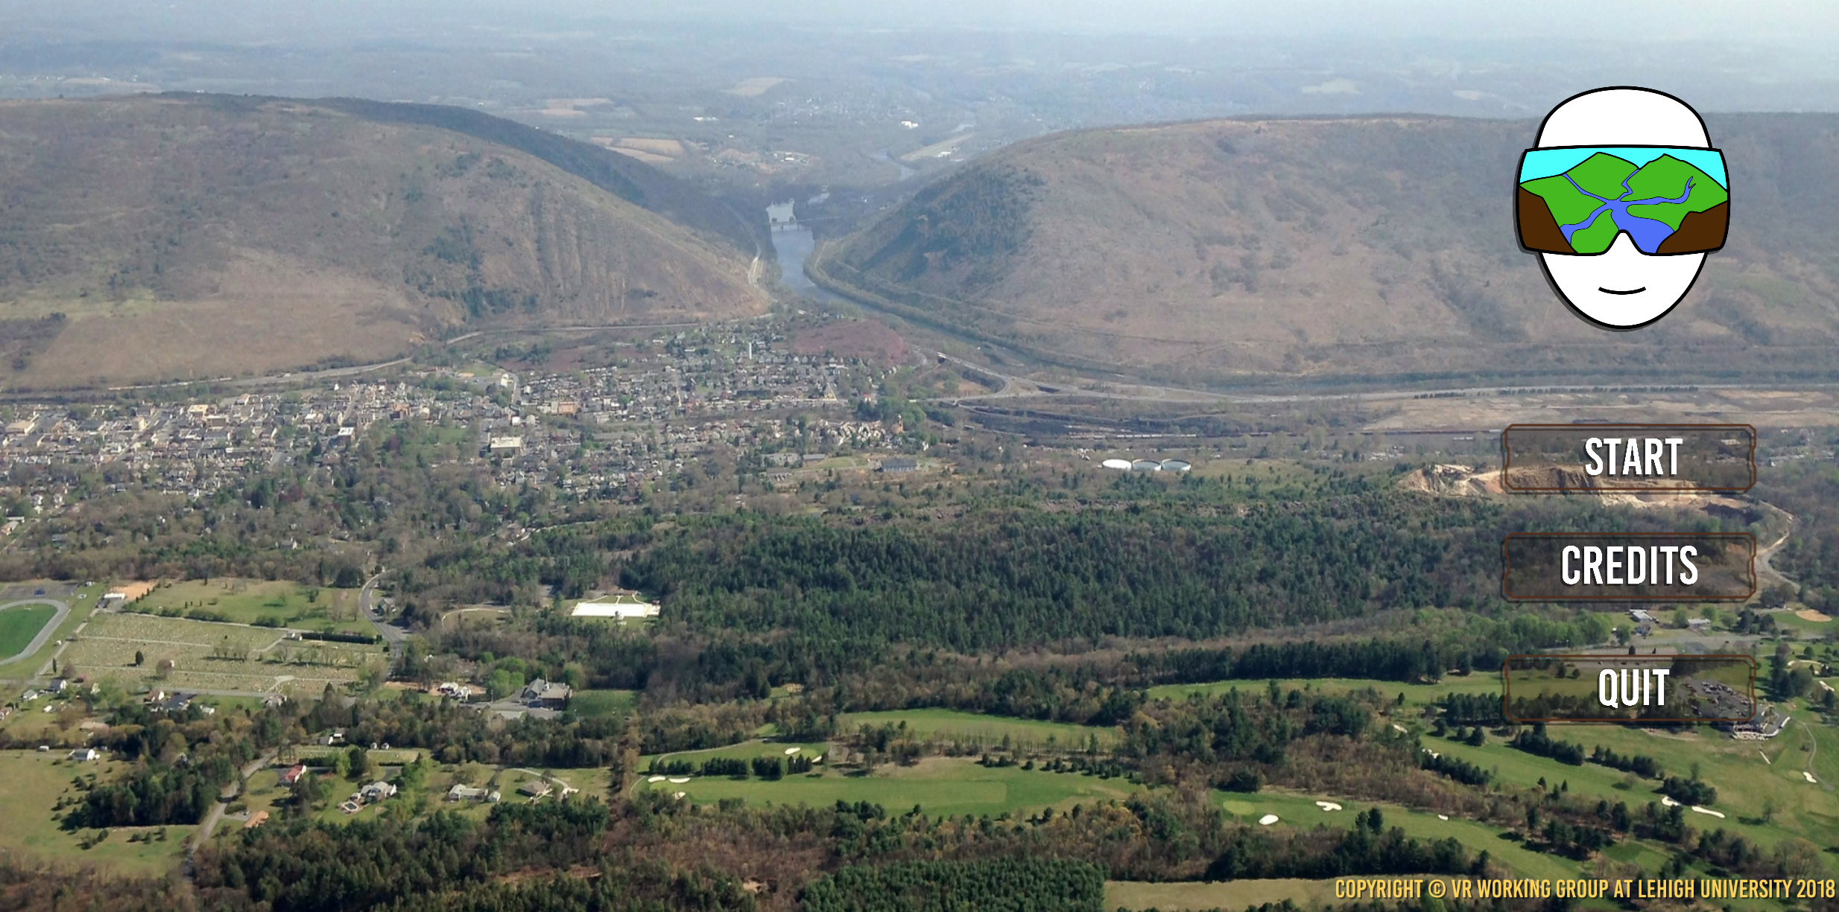

Slide 7
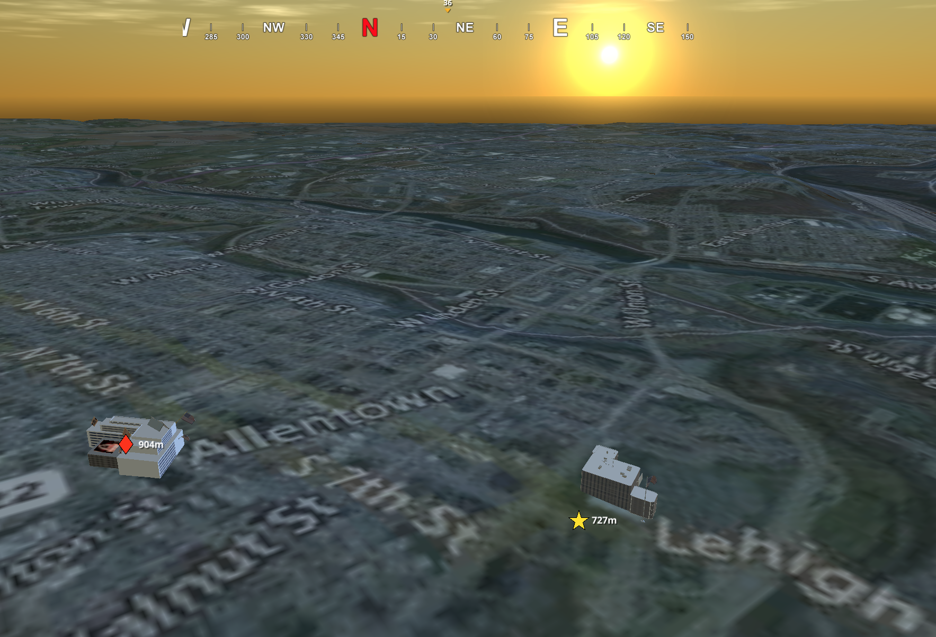

Slide 8
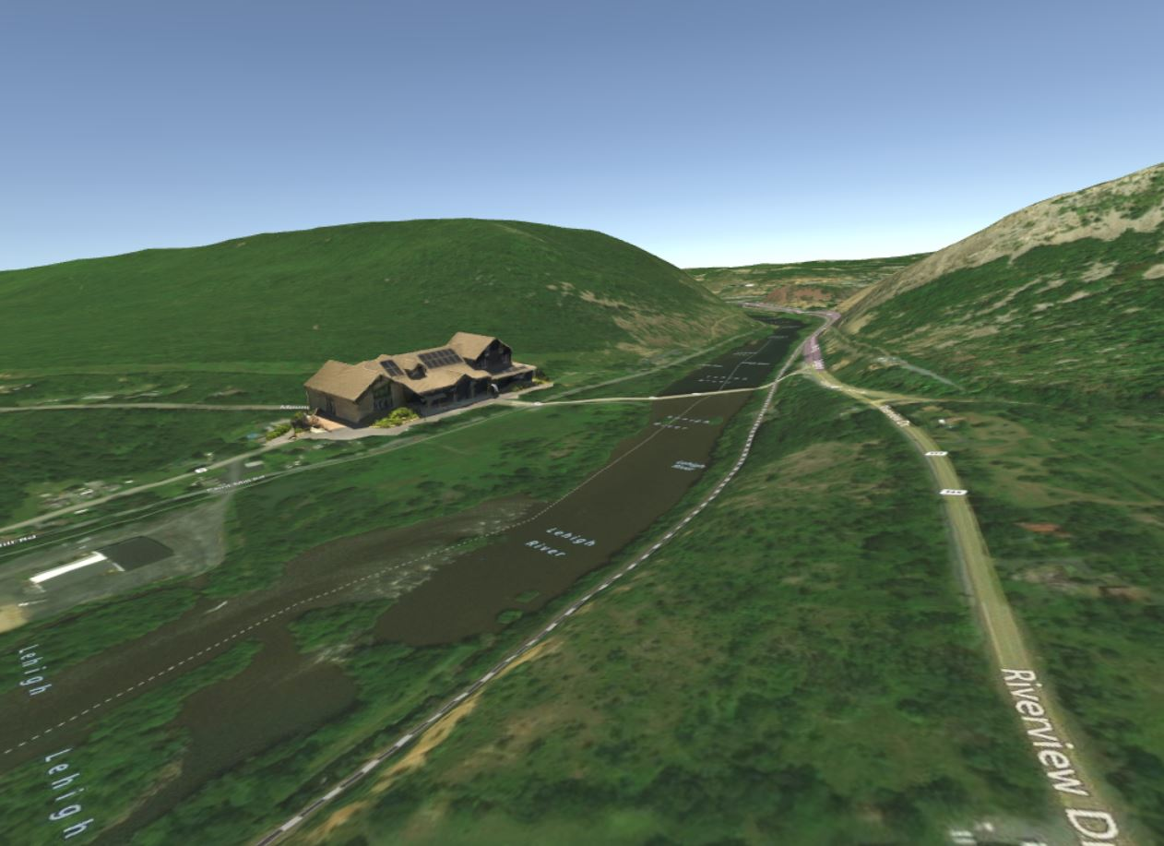

Slide 9
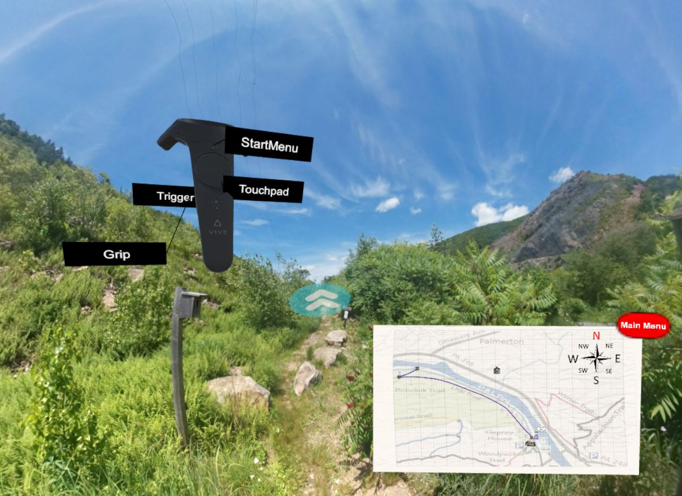

Slide 10
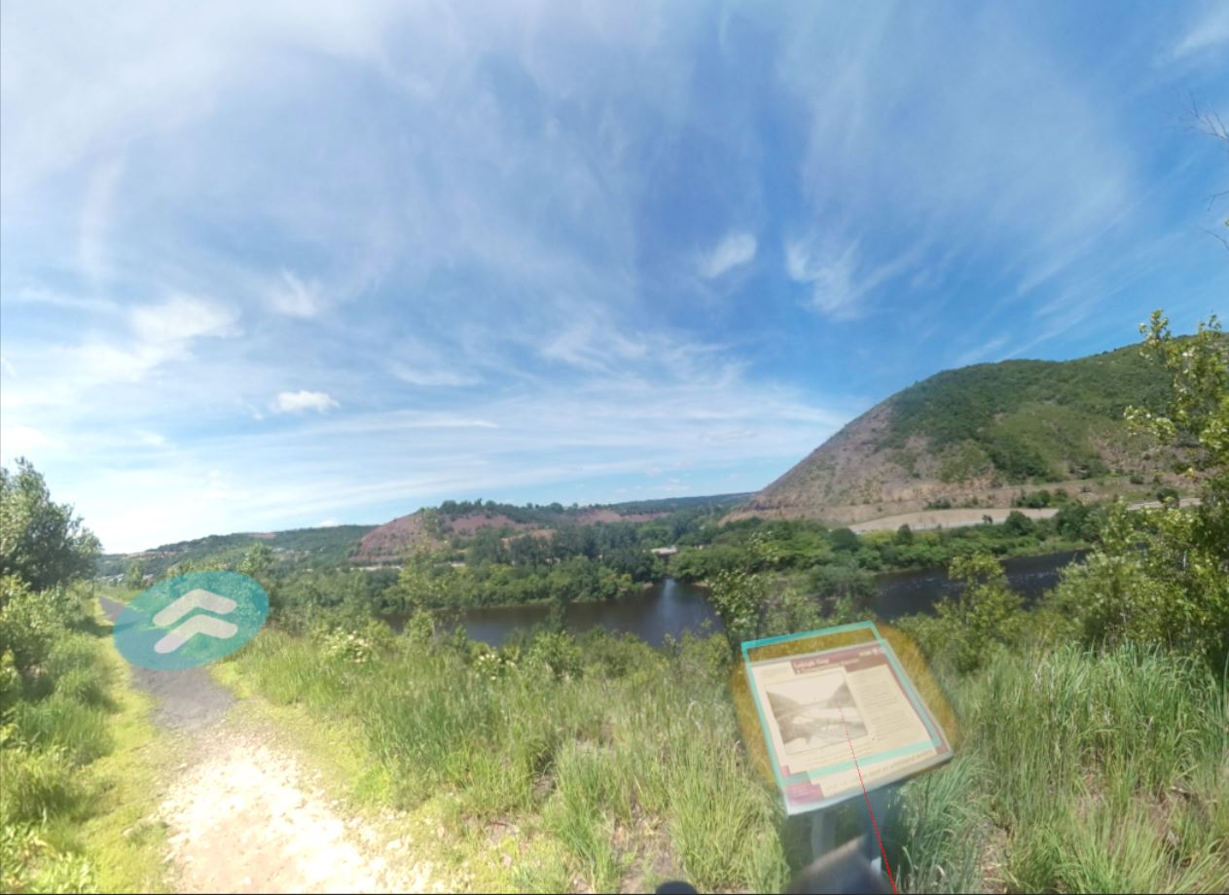

Slide 12
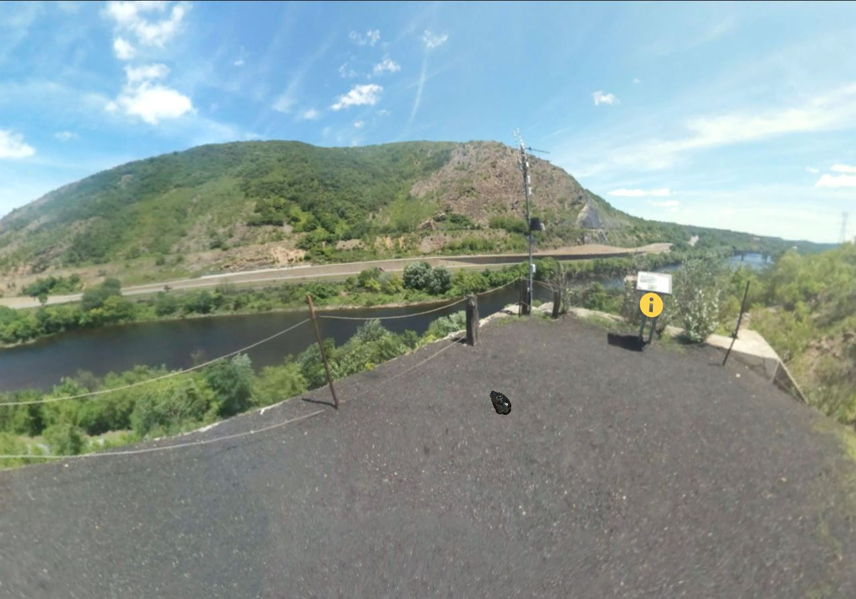

Slide 13
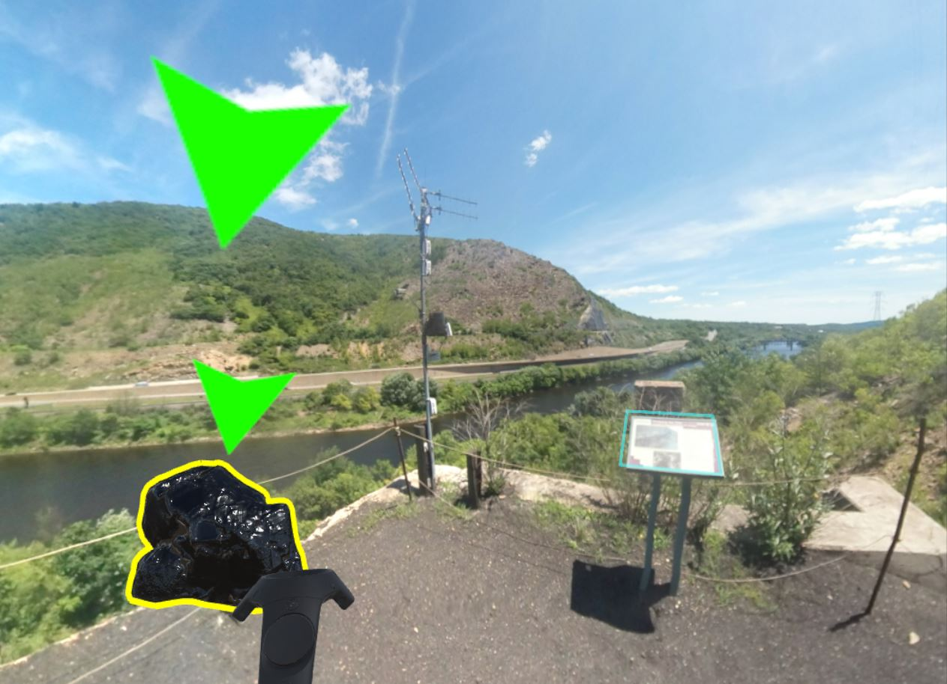

Slide 15
What’s Next:
Adding additional content
Prototype testing with Oculus Go

