Slide 1
The Impact of STEM Mentors in Technology-Driven Socio-environmental Science Investigations
¹Kate Popejoy, ²Alec Bodzin, ²Thomas Hammond, ²Qiong Fu, and ²William Farina
¹Popejoy STEM, LLC
²Department of Education and Human Services, Lehigh University
Association for Science Teacher Education (ASTE) Annual Conference January 8-11, 2020
DRL-1614216

Slide 2
Socio-Environmental Science Investigations (SESI)
Inquiry-based investigations
Map-based mobile data collection
Analysis with Web-based mapping software
Pedagogical frameworks of place-based education and socio-scientific investigations
Local issues
Field work in the local setting
Notes:
For those who don’t know our work…

Slide 3
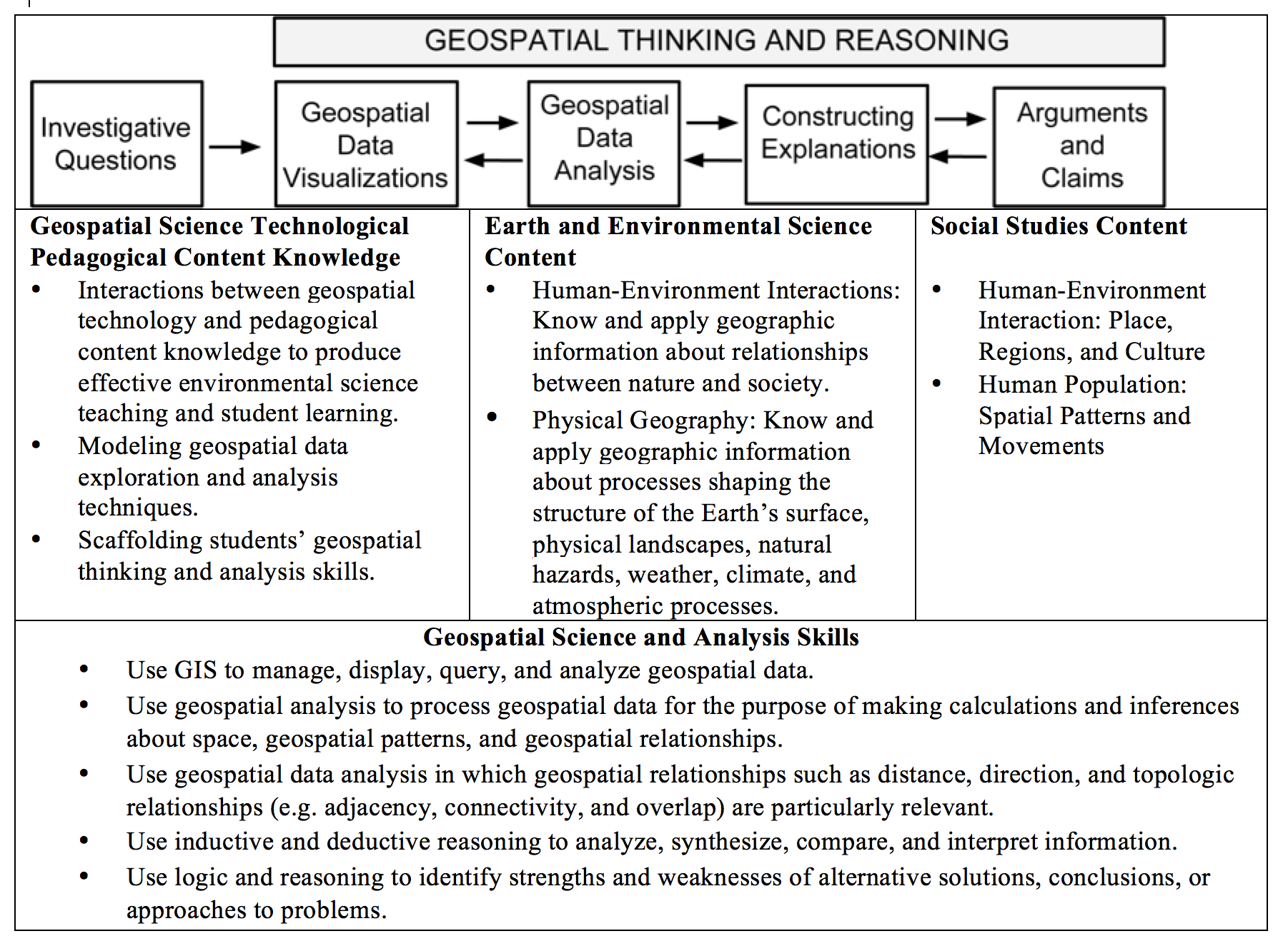

Slide 4
Study setting and participants
Urban public high school
9th graders; n~150/year
All students economically disadvantaged
Two thirds are Hispanic or Latino
21% ELL, 19% IEPs
Many, but not all, students are unengaged learners
Do not complete tasks
Avoid challenging work

Slide 5
SESI Investigations
Trees and Ecological Services
Urban Heat Islands
Carbon Sequestration
Transportation Modes
Ecosystem Scavenger Hunt
Built Environment Scavenger Hunt
Zoning
Projects: Tree Planting, Built Environment, Culminating

Slide 6
Why mentors?
Help students recognize how STEM learning connects to real problems, social contexts, and careers
Two thirds of teens in ACTE survey (2009) discouraged in STEM careers as knew no one in the field
Connections to careers can bring purpose to students’ learning & guide them in thinking about their future.
Attract students who may be marginalized in traditional education and present opportunity for engaging more students in STEM careers (NASDCTEC, 2013)
Mentors provide role modeling, monitoring, guidance, advice, and learning through shared activities
Notes:
Association for Career and Technical Education. (2009). CTE’s role in science, technology, engineering and math. Alexandria, VA: Author.
National Association of State Directors of Career Technical Education Consortium. (2013). Career/technical education: Not your father’s vocational education. Silver Spring, MD: Author.

Slide 7
Mentors from a variety of contexts
PPL
an arborist, a compliance attorney & the volunteer coordinator
City of Allentown
GIS Office, Planning Dept., Shade Tree Commission
Lehigh County Conservation District
Penn State Extension Master Watershed Steward
Da Vinci Science Center
Lower Macungie Township Environmental Advisory Board
Lehigh University faculty, staff & students

Slide 8
Mentor Recruitment & Challenges
Began at NSF proposal stage and acquired letters of support
Some entities allow mentoring during work hours, others do not
Some allow during work hours only for salaried employees, not hourly
This can limit the types of careers students see
Most companies see volunteer work as a “one and done” activity, rather than an ongoing commitment and/or relationship
City employees welcome opportunity to interact with residents, including students, but are already overscheduled
Can take time to find the right people…often get leads from current mentors for additional people

Slide 9
Mentor Preparation
Developed Mentor Training web site (https://eli.lehigh.edu/sesi/mentors)
Pedagogy
Classroom Management
Interpersonal Relations
Each area has videos from Techbridge Girls (used with permission)
Good site, but underutilized by mentors
Detailed email with content, etc., for each investigation
F2F classroom training
Clearances were not required as mentors never alone with students
Notes:
Note that clearances can sometimes be a serious issue.

Slide 10
Mentor activities
Share content knowledge and work background
Help supervise data collection outdoors
Guide students’ exploration of the Web GIS data visualizations or analysis
Provide feedback on students’ explanations or final arguments (informal and also tree proposal judging)
Prioritized sustained involvement over days, rather than cycling a large number of single-visit mentors in and out across multiple learning activities

Slide 11
Mentor Perception Survey (mentee)
Developed in Y2 (n=146)
15 Likert Items, 1= strongly disagree, 5= strongly agree
Cronbach’s alpha = 0.903
In Y3, given to students after each investigation (TES, UHI & Zoning)

Slide 12
Mentee Survey results Y3 (part 1)
 | TES Average N=133 mean | UHI Average N=126 mean | Zoning Average N=116 mean | Combined Average mean
I learned a lot from the mentor(s) | 3.66 (.945) | 3.79 (.873) | 3.78 (.943) | 3.75 (.720)
I enjoyed the time spent with the mentor(s) | 3.51 (1.098) | 3.60 (1.005) | 3.69 (.982) | 3.59 (.826)
I understood what the mentor(s) was telling me | 3.62 (.985) | 3.87 (.958) | 3.81 (.968) | 3.78 (.749)
Mentor(s) talked with me about what she or he does at work | 3.03 (1.083) | 3.13 (1.024) | 3.18 (1.162) | 3.14 (.838)
Mentor(s) shared how what we were doing in class relates to his/her work | 3.39 (1.040) | 3.23 (.965) | 3.36 (1.075) | 3.37 (.793)
Mentor(s) seemed interested in me | 3.11 (.933) | 3.33 (.935) | 3.33 (1.070) | 3.26 (.684)
Mentor(s) asked me about school | 2.82 (1.083) | 2.88 (.968) | 3.01 (1.096) | 2.89 (.780)
Notes:
1= strongly disagree. 5= strongly agree

Slide 13
Mentee Survey results Y3 (part 2)
 | TES Average N=133 mean | UHI Average N=126 mean | Zoning Average N=116 mean | Combined Average mean
Mentor(s) asked me about my plans for future schooling | 2.74 (1.083) | 2.94 (1.079) | 2.94 (1.131) | 2.91 (.804)
Mentor(s) made the work we were doing easier | 3.55 (1.080) | 3.76 (.970) | 3.73 (1.096) | 3.65 (.847)
Mentor(s) taught me new skills | 3.42 (1.092) | 3.37 (1.026) | 3.53 (1.095) | 3.47 (.913)
Mentor(s) provided me with constructive feedback | 3.37 (.965) | 3.50 (.912) | 3.54 (1.050) | 3.49 (.738)
Mentor(s) assisted me with outside iPad data collection | 3.84 (.944) | 3.77 (.943) | 3.80 (.944) | 3.79 (.789)
Mentor(s) assisted me with inside data analysis with the Web GIS map | 3.78 (.856) | 3.63 (.961) | 3.67 (.958) | 3.70 (.707)
I would like to have a mentor work with me again | 3.41 (1.135) | 3.58 (1.134) | 3.63 (1.195) | 3.56 (.917)
Notes:
In general, the students valued their time with the mentors, learned how the geospatial investigations related to STEM-related career pathways, and noted that the mentors facilitated new skill development. A majority of students has favorable perceptions of the mentors with assisting them with geospatial data collection and analysis. The students noted that most mentors did not talk about school or plans for future schooling with the students. While the online mentor training modules did address talking with the students about the importance of STEM classes and school in general, more explicit training in this area should have taken place either through email correspondence or face to face interactions with the mentors.

Slide 14
Impacts of mentors: TES
For TES Investigation, we needed a tree ID app that would work offline. No such app existed. Power company Arborist worked with grad students to identify all trees on school and adjacent properties. We able to create a taxonomic iBook for iPads to allow students to identify trees in the field.

Slide 15
Impact of Mentors: Tree Planting
Students created Tree Planting proposals
Finalists judged by panel of mentors
“Winning” trees planted in partnership with the city, at no cost to school, with long-term maintenance provided by city
First wave May 2019
Second wave October 2019

Slide 16
References
Association for Career and Technical Education. (2009). CTE’s role in science, technology, engineering and math. Alexandria, VA: Author.
National Association of State Directors of Career Technical Education Consortium. (2013). Career/technical education: Not your father’s vocational education. Silver Spring, MD: Author.

Slide 17
Questions and Comments
Paper available: https://eli.lehigh.edu/publications/research
SESI materials available: https://eli.lehigh.edu/sesi/
To access assessment materials: Login: eliteacher Password: 87dja92

