Slide 1
Paper Number: 151-11 Teaching and Learning Tectonics with Web GIS
David Anastasio
Leonard Acuta, Scott Rutzmoser, Dork Sahagian, Alec Bodzin
DR K-12 Award 1118677
Environmental Literacy and Inquiry
http://www.ei.lehigh.edu/eli
Notes:
Spatial reasoning skills help us manipulate, interpret, and explain spatially referenced data and improve higher-order cognitive processes including problem solving and decision-making. These skills can be taught and learned with well-designed technologies, software, and curricula. My co-authors and myself have developed an intuitive and easy to use Web-GIS graphical interface. The Web GIS interface facilitates data visualization and analysis. Today, I will highlight Tectonics investigations designed to augment traditional learning activities. I will also discuss implementing a widely used college plate tectonic exercise with the same interface. Our activities, depending on what teacher and student scaffoling are used, are appropriate and effective from middle school through college classrooms.
Our research team includes a includes a colleague from my department Dork Sahagian, Alec Bodzin from Lehigh’s College of Education, Scott Rutzmoser, a GIS specialist from Library and Technology Services, and RAs. The work by Lenny Acuta on the plate game is featured today.

Slide 2
http:www.ei.lehigh.edu/eli/tectonics
Notes:
These investigations are available on our Environmental Literacy and Inquiry website. This is what you will see when you visit the Tectonics home page. Much of the curriculum we house on the ELI website is for middle school students, examples include an 8 week Energy unit, a 3 week Climate unit and a 3 week Land Use unit the Tectonics activities I will show today are also housed there, as our many of our papers and presentations that have resulted from our groups collaborative efforts. Today I will highlight a few of the curricular enhancements to demonstrate the GIS interface and tool box wigits that we have developed.
The javascript based Web GIS was created to be platform independent, meaning it can be used on tablets, laptops, cell-phones, and desktop computers with no special software.
Content and pedagogical supports for teachers to implement the investigations were also created and presented as both written documents and video walk-throughs and tutorials

Slide 3
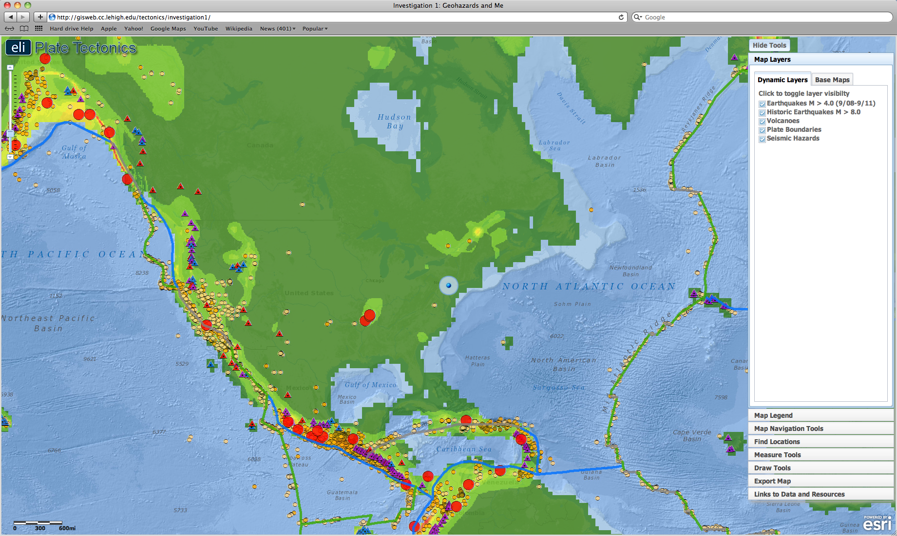
Where is the nearest geologic hazard to my location?
Custom GIS for each activity
Notes:
Here is a simple start for beginning students, where students locate tectonic hazards near their location. This takes advantage of the location function now built in to many devices. They will:
• Discover where the most recent earthquake occurred near their location and where the nearest volcano is located. • Investigate how geologic hazards are distributed around the globe and infer how this is related to plate tectonics.
On screen is a view of the web GIS with earthquakes epicenters, volcanoes, plate boundaries layers and the USGS tectonic hazards layers turned on.
Students can focus the map on their location by either using the gps feature on their computer, or typing in their address to the find my location
Students can use a measure tool to determine the distance from their location to the nearest geologic hazard

Slide 4
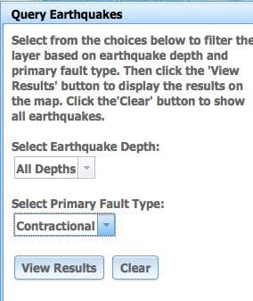
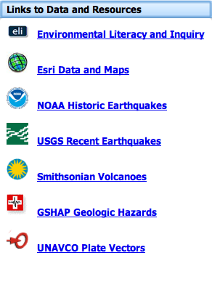
Where is the nearest geologic hazard to my location?
Volcano
Type
Earthquake
Query
GPS vectors / Historical seismicity
Notes:
Some of the Legend Features:
Customized GIS for different investigations.
For Epicenters we have a Earthquake Query tool and coverages that parse the data sets to support specific activities: for example historic earthquakes along the San Andres, large magnitude events, foci depth ranges, earthquake type, all M4 or greater events for 2 year period, a time window that controls load times
Volcanoes are separated by type/composition
The inset expands CA to show GPS vectors from UNAVCO and historic earthquakes.
We use current data from USGS, NASA, UNAVCO, Smithsonian Volcano Repository
Computer location feature, measurement tools, and external links to data and resources.

Slide 5
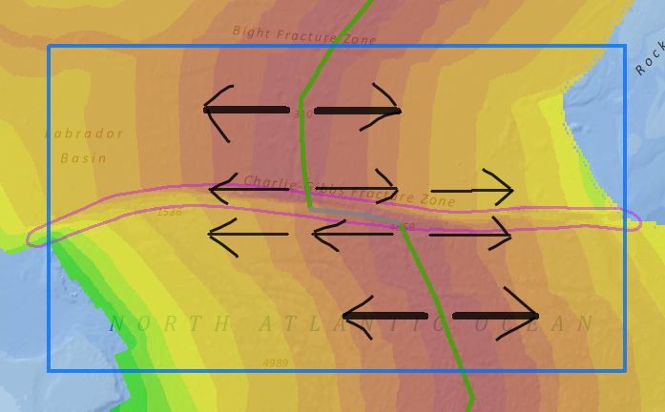
Transform Faults and Fracture Zones
Transform fault
Fracture zone
Notes:
Coverages of earthquake epicenters and age of the ocean floor are used with the draw tool to elucidate the Mid-Atlantic Ridge plate boundary and helps students discover the difference between transform faults and fracture zones at a mid-ocean ridge
Here they locate the Charlie-Gibbs Fracture zone using earthquake and age of the ocean floor data. Then they use a draw tool to indicate plate motion and by comparing the relative plate motions across the ridge distinguish between Transform faults and Fracture zones while easily toggling back and forth between bathymetry and crustal age layers, note the transform faults is where the epicenters are then they use an Export tool to submit their analysis by email.

Slide 6
Heat Flow in the Earth
Notes:
Web-GIS makes difficult concepts more tractable. For example consequences of heat flow in the Earth, connections to ocean spreading, bathymetry, and hot spots
This investigation utilizes the swipe tool. By clicking the vertical bar, students can swipe one layer over another to compare the 2 layers and identify the spatial patterns between the layers. Here you see the Surface heat layer on the left being compared to the age of the ocean floor layer to learn that the hottest crust is the youngest crust at a divergent plate boundary in the ocean. As you can see the ages of the ocean floor line up red to blue with red being the youngest blue being the oldest, and the surface heat floor layer, red indicates warmer values, blue indicates colder.
As the cursor moves so does the location indicator (lat/long)
Note the cursor location tool in the lower left

Slide 7
Continental Boundaries
Notes:
For divergent boundaries students calculate a half spreading rate using the age of the ocean floor coverage and the measure tool, explore passive margin development and the GIS introduces potential field data, here Bougier gravity anomaly is shown coincident with the change in crust type at continental boundary and then compare this to topography/bathymetry layer. It is easy to see that this is coincident with the continental shelf edge.

Slide 8
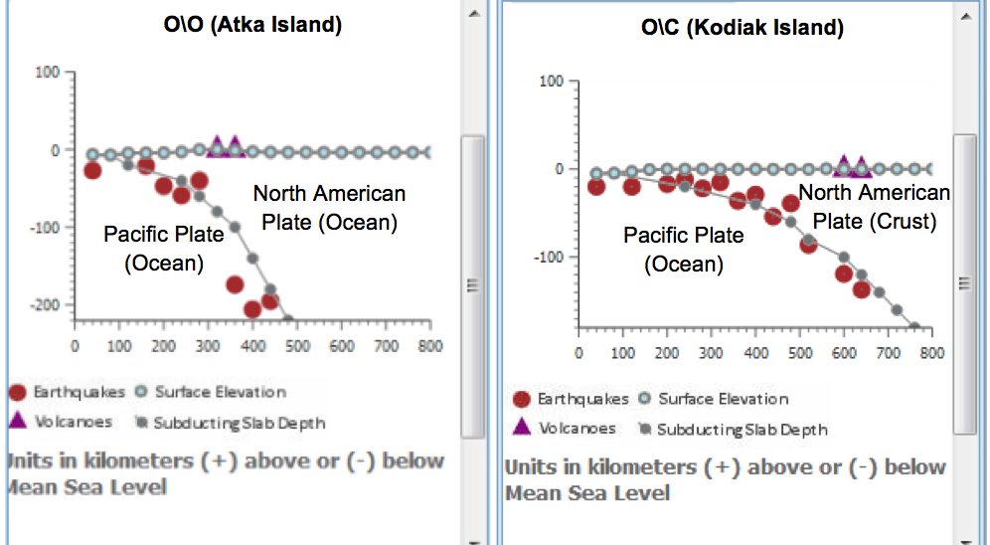
Convergent
plate
boundaries
Subduction zone
profiles
Notes:
Here is an example where students can use the distribution of earthquakes and volcanoes to learn about subduction zones by comparing along strike changes in the Aleutian arc from O/O subduction in the west to O/C subduction in the east
This screenshot is showing how students can use the depth to slab, earthquakes, and volcanoes layer to determine the dip of the subducting slab. In the subduction zone profile tool seen on the right, students can identify on which plates the deep earthquakes occur on and which plate they see volcanoes at the surface. This is an interactive profile. Students can place their cursor over the line on the map to see the corresponding point on the subduction zone profile. Depth contours on the subducted slab are shown
By looking at multiple profiles, students can easily see changes in subduction zone geometry along strike and how the Arc/trench gap varies with the dip of the subduction zone.
We were North America centric by design in but most of the data sets are global so custom activities are readily possible.

Slide 9
The Plate Game Using Web-GIS
Plate Game original creation Peter Coney, Middlebury College early 1970s,
geophysical data added by Dave Chapman and Kevin Furlong, University of Utah 1980s
Notes:
The last example is a Tectonics laboratory in my Structural Geology and Tectonics class. The exercise arrived at Lehigh University before me through Terry Pavlis who studied at the Univ. of Utah. Implementation with Web-GIS has enhanced the exercises effectiveness. Currently my students complete a 2 week exercise with week 1 an introduction to the data sets, the Web-GIS tool and then they spend the lab determining the Present Plate Boundaries using geological and geophysical data to create an Age of the Ocean Floor map. Students can return to their exercise anywhere and anytime over the web. The assignment consists of a series of plate reconstructions which restore ocean floor and match on land geology.

Slide 10
Geology and Marine Geophysical Data
Notes:
Magnetic anomalies, earthquake epicenters, and volcano locations appear with cursor rollover over ship tracts, marine locations or legend click. The data layers also include drilling records, bathymetry, heat flow, and geologic records including orogenic events, an accreted terrane and modern and ancient basins. Students begin by correlating internally consistent magnetic anomaly record, drilling records, and marine geophysical records to generate an Age of the Ocean Floor Map. The drilling records include biostratigraphic data and appropriate age-thickness and depth-sediment type relations. The toolbox includes drawing tools, a text editor, and continental shapes.

Slide 11
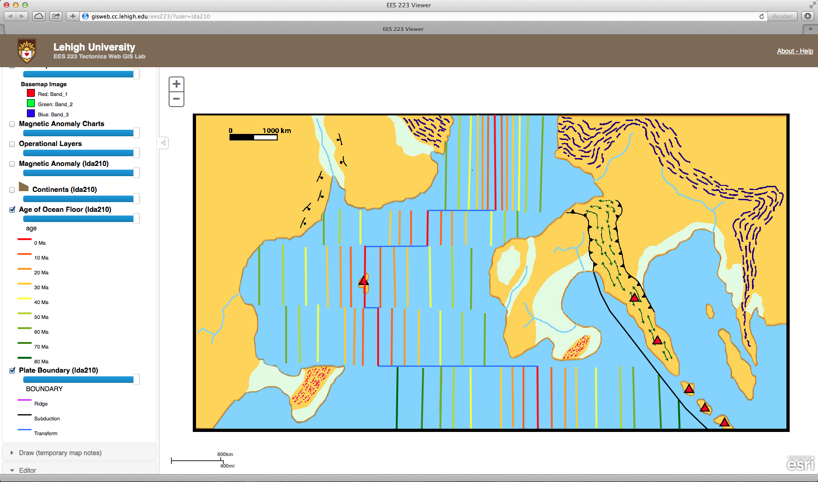
Age of the Ocean Floor
Present Plate Boundaries
0 Ma
Notes:
Goal of the first 3 hour laboratory period, the age of the ocean floor is mapped and Present Plate Boundaries are determined. Divergent boundaries, convergent boundaries, and transform boundaries are shown in red, black, and blue, respectively. Real-time instructor feedback is facilitated by the web-GIS. Projection in a computer classroom makes coaching the assignment easy. Note the variable rates throughout the ocean.

Slide 12
Sequentially
completed
restorations
Independently
completed
over the Web
Electronically
submitted
assignment
20 Ma
60 Ma
80 Ma
Notes:
Once the age of the ocean is created, students use continental shapes to restore ridge spreading to generate restorations at assigned time periods. Spreading rate and ocean sedimentation embellishments are built into the data sets.
Student sequentially complete restorations, in or out of class, they can log into their evolving assignment and submit their work electronically when it is completed.
Enhancements currently under development include full marine bathymetry, heat flow, sediment records and magnetic data sets. Once these raster coverages are incorporated, students will generate data of their choosing with an allowed budget as motivation. The revised assignment will be piloted in the spring 2015 semester.

Slide 13
Conclusions
–Significant learning increase in tectonics content and geospatial thinking and reasoning compared to business as usual instruction
–High student engagement during activities and learning by exploration trial and error was effective. Web-GIS timulated student discovery by promoting more frequent interactive synthesis
–The assignments promote scientific reasoning (e.g. consideration of multiple working hypothesis)
–Lehigh undergraduates in Structural Geology and Tectonics need scaffolding to investigate hotspot distribution but not transform faults, ocean age-bathymetry relations, or subduction zone structure.
–Inquiry-based assignments allow students to creatively apply tectonics content but they require appropriate background knowledge
-Web-GIS allowed faster student completion and real-time instructor feedback

Slide 14
Questions http://www.ei.lehigh.edu/eli/tectonics
Further Description
Burrows, J., Bodzin, A., Anastasio, D., Sahagian, D., Bressler, D., Cirruci, L., Rutzmoser, S. and Teletzke, A. (2013). Using Web GIS to enhance tectonics learning and geospatial thinking. Science Scope, 37(4), 29-37.
Acknowledgements
Allison Telezke and Jill Burrows, Earth and Environmental Sciences, Lehigh University
Denise Bressler, Education and Human Resources, Lehigh University
Lori Cirucci, Bethlehem Area School District

